Slide 1
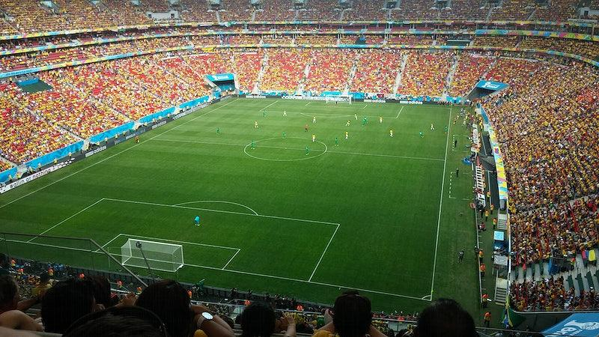
DATA ANALYSIS AND VISUALIZATION- FINAL PROJECT
MANVIKA SHARMA
VEDASAMHITH ALLOORI

Slide 2

Topic: FIFA players & team analysis
We have 2 datasets, for the years 2015 and 2022 respectively.
We understand our data on Python, the variables, data types, missing values, and other crucial information on Python.
Later, we have done the projected the visualizations on Tableau.

Slide 3
Introduction
Dataset is available at:
https://www.kaggle.com/datasets/stefanoleone992/fifa-22-complete-player-dataset
Project objective:
Preliminary analysis to understand our data. Clean the data & apply analytical techniques using python
Pick the appropriate features for our visualization
Formulate problem statements for analysis & create visuals on Tableau to get essential insights
Utilizing MS Excel for data aggregations & execute consistency checks
Advanced exploratory data analysis, to understand the correlations between features

Slide 4
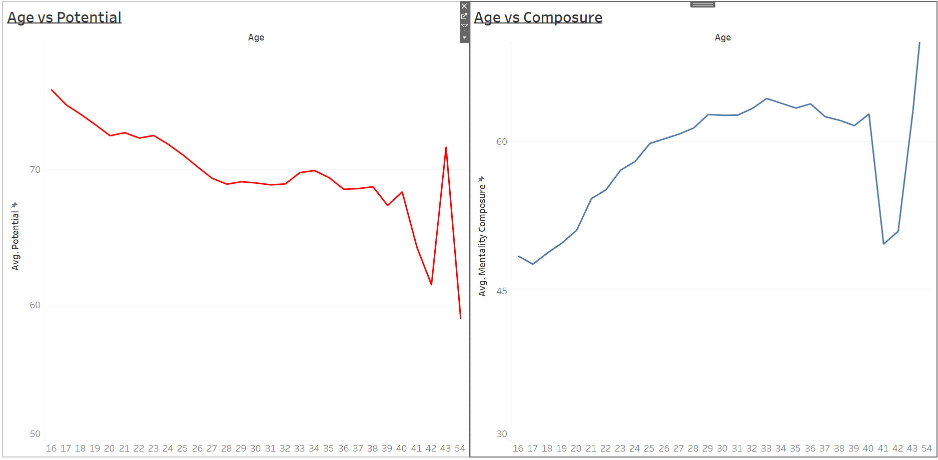
DASHBOARD-1
Insights:
We see that the potential of a player decreases very early in their career.
The composure increases with age, as the player understands how to read the game better and gets a grip of the game which makes them calm.

Slide 5
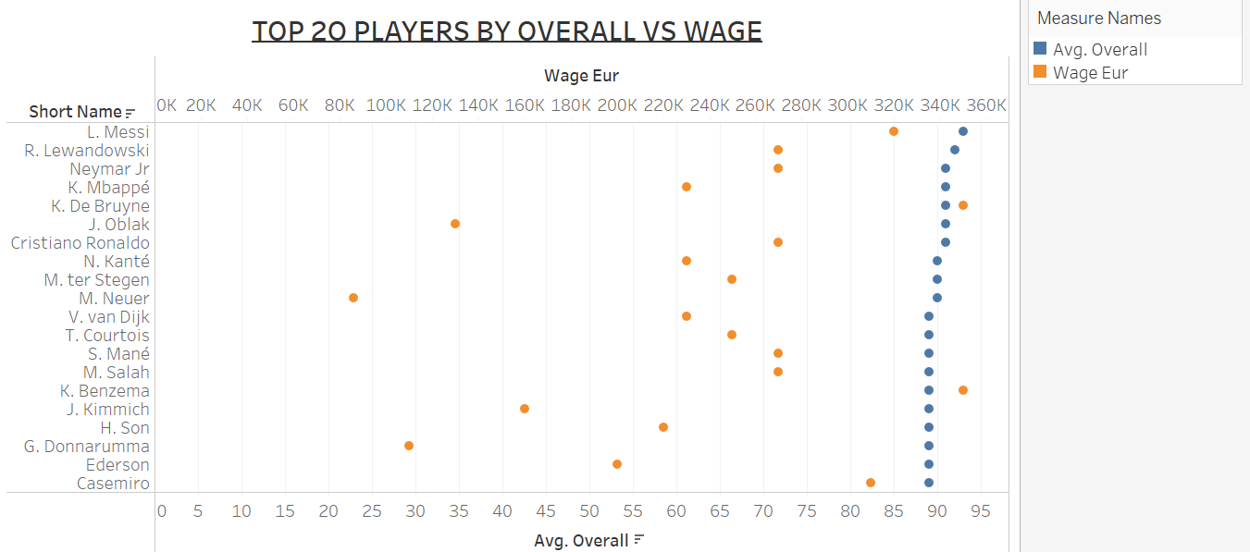
DASHBOARD-2
Insights:
This Visualization depicts the top 20 players by the average overall vs the wage in euros.
We can see the wage depends on the player’s game and not on the overall.

Slide 6
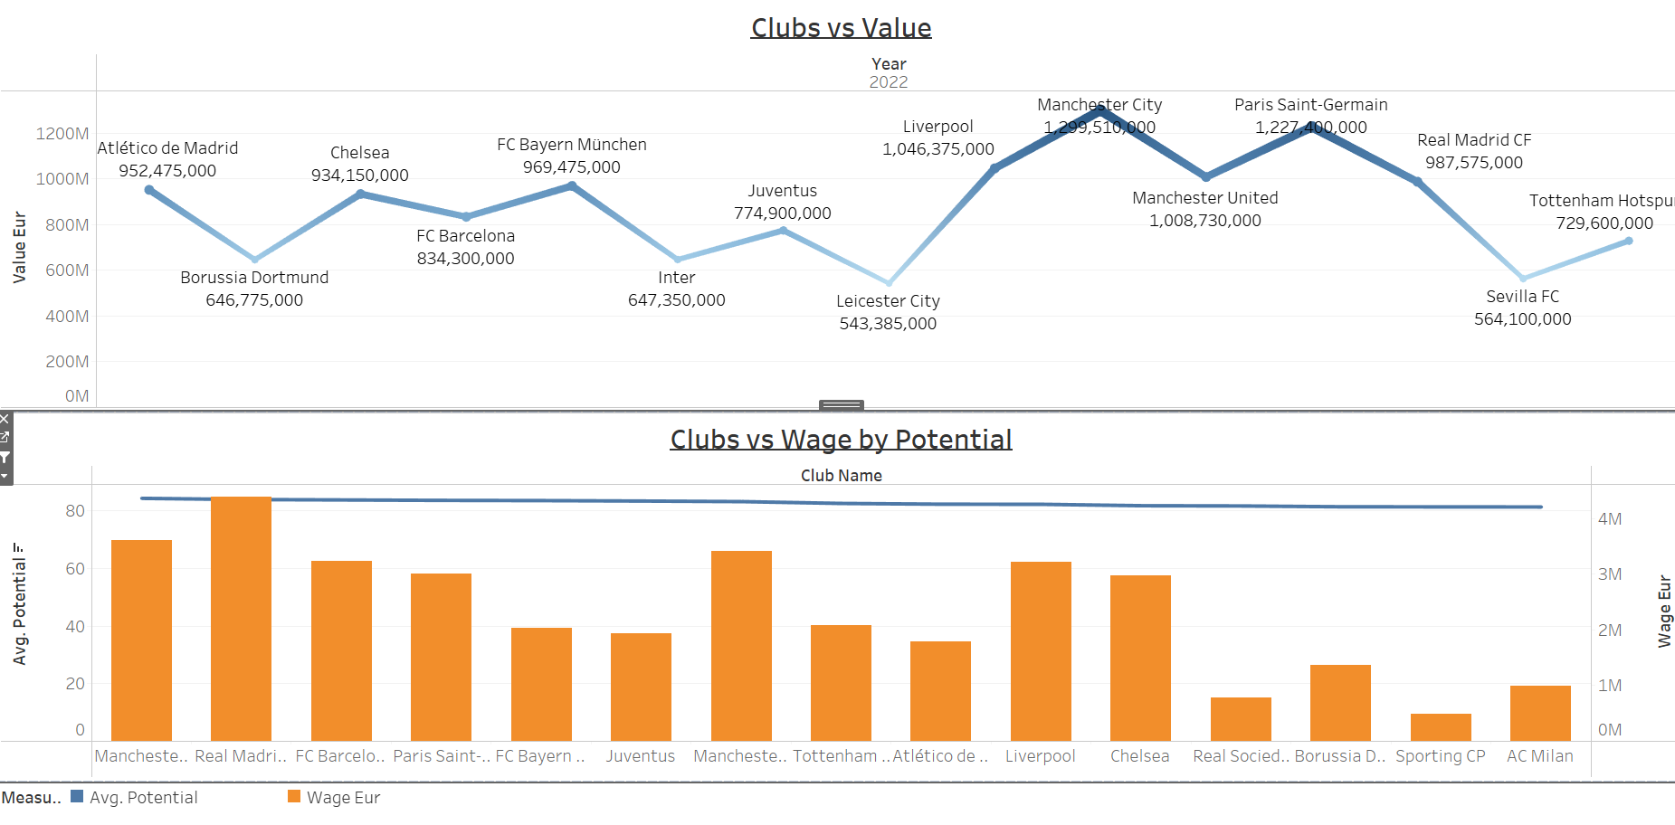
DASHBOARD-3
Insights:
The visualization depicts the top 15 clubs by the total value in euros for the year 2022.
The next visualization states the top 15 clubs potential for each club.

Slide 7
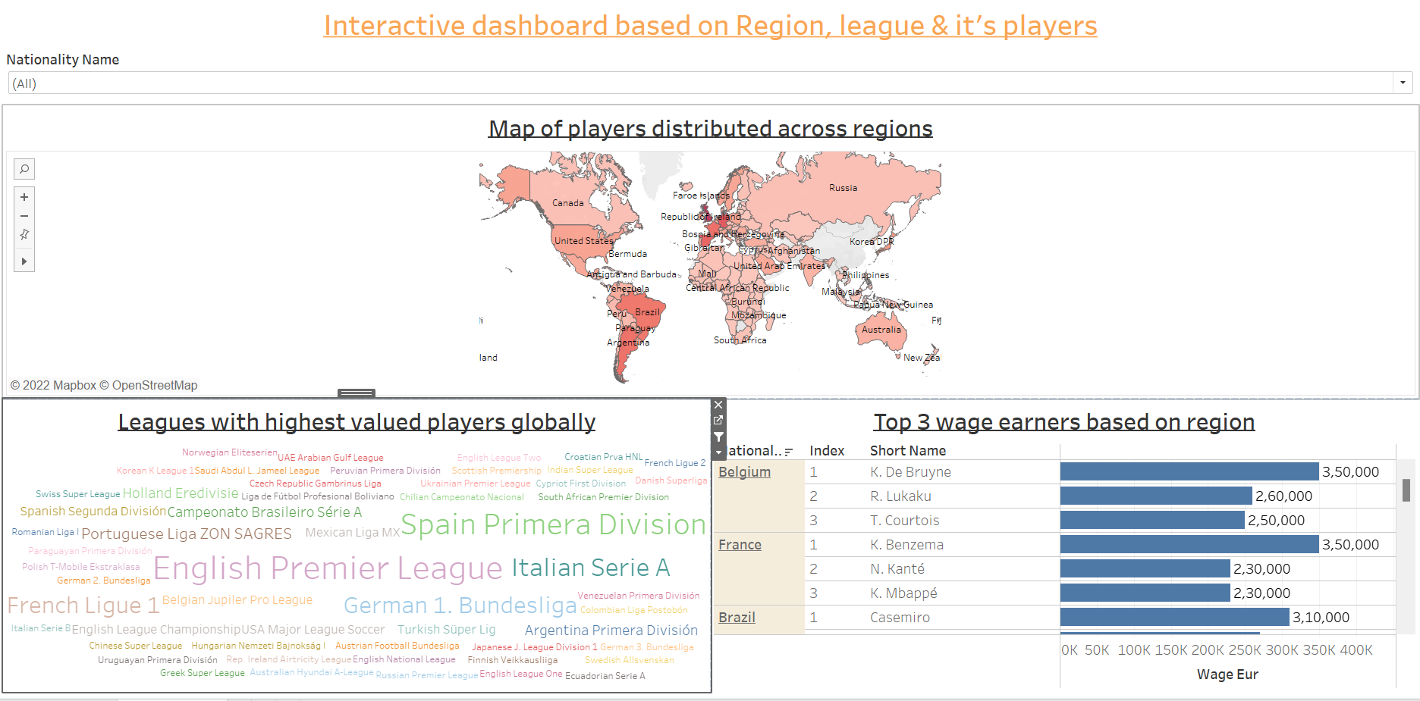
DASHBOARD-4
Insights:
Have created this interactive dashboard based on region, league and its players
The map visualization depicts the total number of players from that country
The text visualization displays the leagues with the highest valued players globally and the total value for each league
The last visualization depicts the top 3 wage earners based on their region.

Slide 8
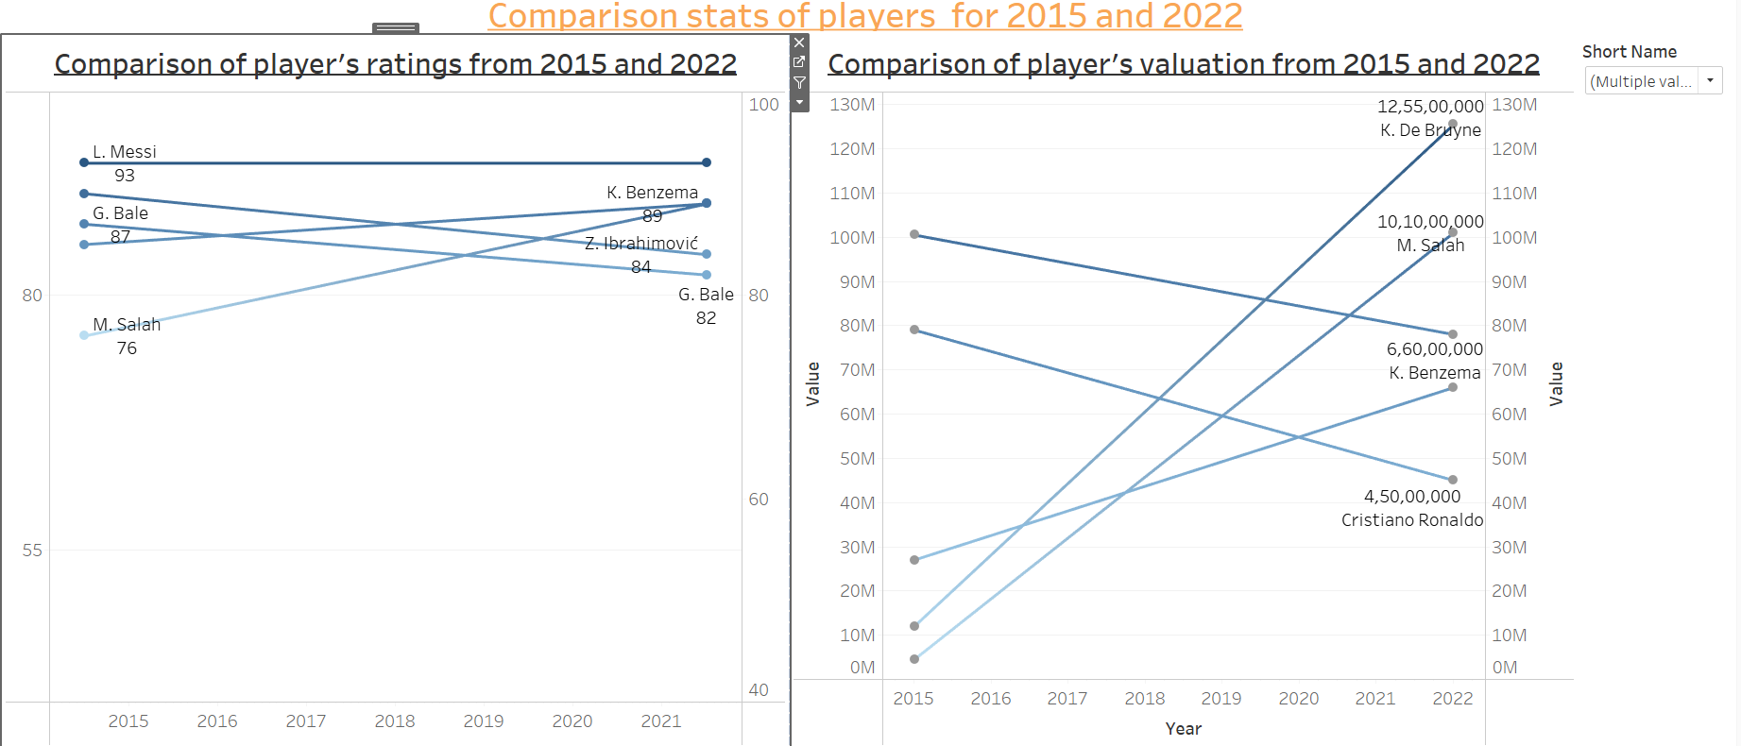
DASHBOARD-5
Insights:
These visualizations represents the rank comparisons between 5 player’s rating and the player’s valuation between 2015 and 2022.
We can see that Messi’s rating has been consistent over the years though Bale’s and Ibrahimovic’s has decreased. Salah’s and Benzema’s rating have increased
Though Ronaldo and Messi have been consistent ,their value have decreased whereas De Bruyne’s and Salah’s Valuation has increased.

Slide 9
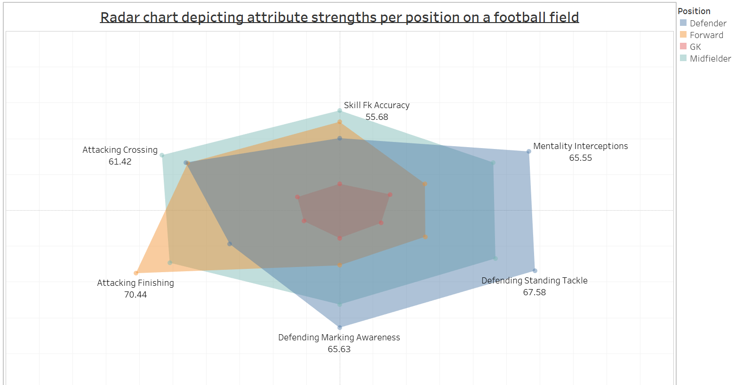
DASHBOARD-6
Insights:
This Radar chart depicts the attribute strengths per position .
No surprise with Defenders getting the
highest ratings in defending attributes such as Standing Tackle, Marking and Interceptions.
Midfielders seem like all rounders. They are good at everything but excel in Crossing and Free kick Accuracy.
Forwards' main job is to score goals.
Hence, it is expected they score the highest in Finishing.

Slide 10
Conclusion
Key learnings through this project:
Apt data cleaning & EDA gives clarity
Choosing the right charts helps give clear insights
Getting hands-on exposure to Tableau’s advanced techniques like calculated fields, joins,unions, parameters, dashboards & storyboards helps in analyzing the data even better
Understanding holistically how Tableau can be such a crucial tool to understand the macroas well as micro facets of a business.

Slide 11

THANK YOU !!!!!!

